Slide 1
LAS PALMAS MIDDLE SCHOOL
SPANISH DUAL IMMERSION PROGRAM

Slide 2
WHAT IS THE MIDDLE SCHOOL MODEL
LAS PALMAS MIDDLE SCHOOL
Las Palmas Middle School is unique to most Dual Language Immersion programs in that we offer students a 7th-period day. Spanish Dual Immersion students will have one additional elective to their require elective of Spanish Language Art. Students in the program will have 30% of their day in Spanish and 70% of their day in English.

Slide 3
The Secondary Model
6TH GRADE
SPANISH 30%
7TH GRADE
SPANISH 30%
8TH GRADE
SPANISH 30%
Ancient World History
Spanish Language Arts
World History
Spanish Language Arts
Pre-AP U.S. History
Spanish Language Arts

Slide 4
History (Spanish)
Math
English
Science
P.E.
Spanish Language Arts
Elective (Student Choice)

Slide 5
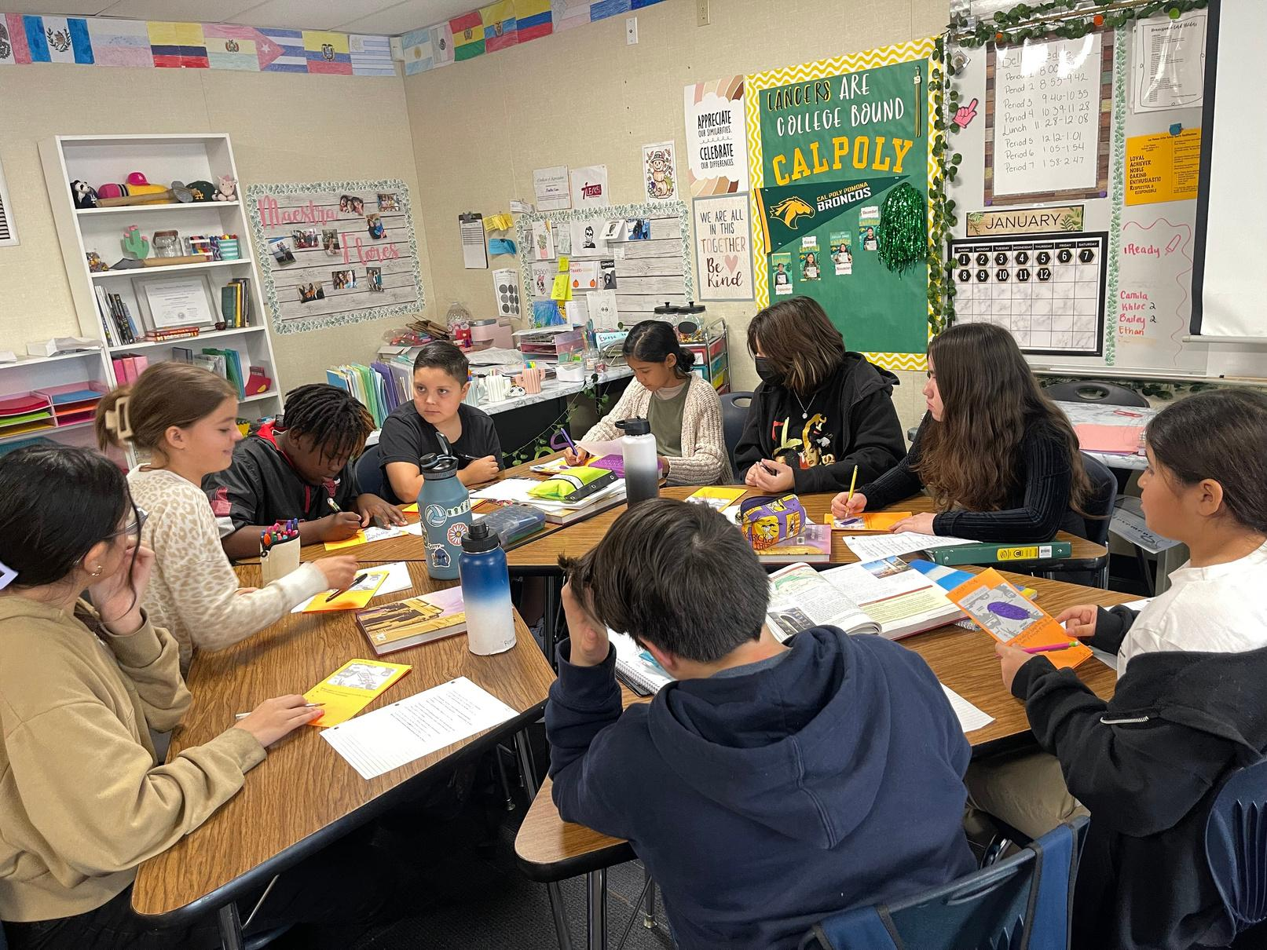
By the time students reach Las Palmas Middle School, students progressed from 90% to 50% per day in Spanish. In Middle School, students are maintaining their language acquisition under the 30% model

Slide 6
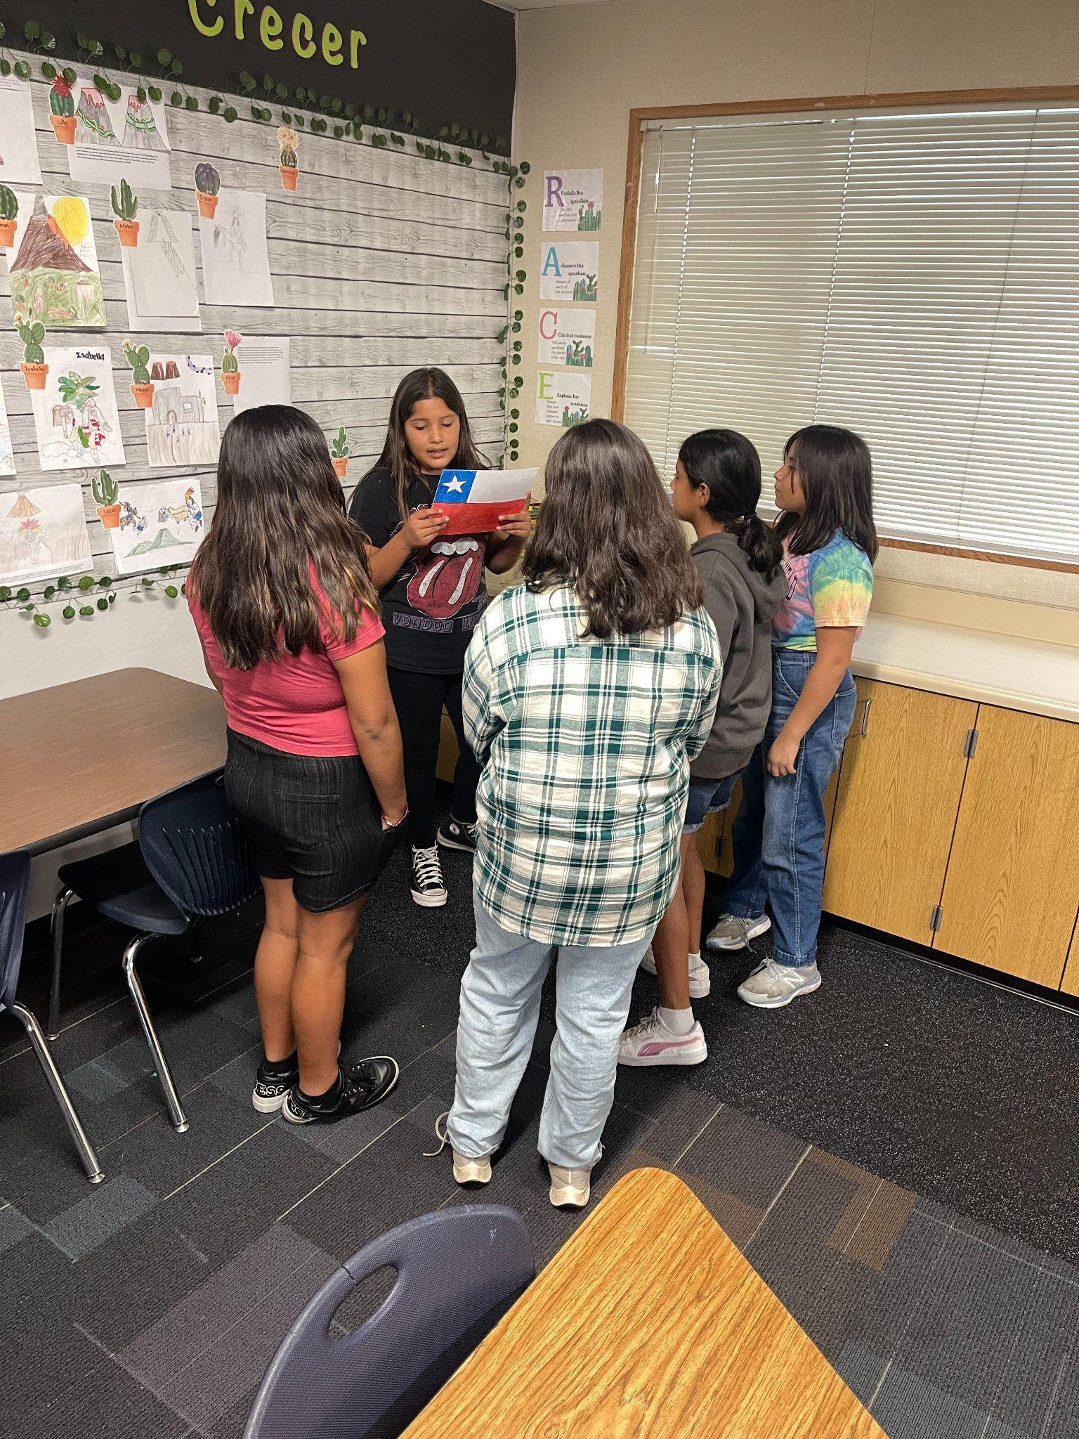
THE GOALS OF DUAL IMMERSION
BILINGUAL & BILITERATE
COLLEGE & CAREER READINESS
ACCESS TO RIGOROUS COURSES
STATE SEAL OF BILITERACY

Slide 7
SEAL OF BILITERACY
THE HIGH SCHOOL SEAL OF BILITERACY
Completion of all English language arts requirements for graduation with an overall grade point average of 2.0 or above.
Passing the California Standards test in English language arts administered in grade 11 at the proficient level or above.
Passing a World Language Advanced Placement examination with a score of 3 or higher
Passing a school district language exam that, at a minimum, assesses speaking, reading and writing passing at a proficient level or higher

Slide 8
Questions?

